Slide 1
In delete operation of BST, we need inorder successor (or predecessor) of a node when the node to be deleted has both left and right child as non-empty. Which of the following is true about inorder successor needed in delete operation?
Inorder Successor is always a leaf node
Inorder successor is always either a leaf node or a node with empty left child
Inorder successor may be an ancestor of the node
Inorder successor is always either a leaf node or a node with empty right child

Slide 2
How many distinct binary search trees can be created out of 4 distinct keys?
4
14
24
34

Slide 3
Which of the following traversal outputs the data in sorted order in a BST?
Level Order
In Order
Post Order
Pre Order

Slide 4
Suppose the numbers 7, 5, 1, 8, 3, 6, 0, 9, 4, 2 are inserted in that order into an initially empty binary search tree. The binary search tree uses the usual ordering on natural numbers. What is the in-order traversal sequence of the resultant tree?
7 5 1 0 3 2 4 6 8 9
0 2 4 3 1 6 5 9 8 7
0 1 2 3 4 5 6 7 8 9
9 8 6 4 2 3 0 1 5 7

Slide 5
The following numbers are inserted into an empty binary search tree in the given order: 10, 1, 3, 5, 15, 12, 16. What is the height of the binary search tree
(the height is the maximum distance of a leaf node from the root)?
2
3
4
6

Slide 6
The preorder traversal sequence of a binary search tree is 30, 20, 10, 15, 25, 23, 39, 35, 42. Which one of the following is the postorder traversal sequence of the same tree?
10, 20, 15, 23, 25, 35, 42, 39, 30
15, 10, 25, 23, 20, 42, 35, 39, 30
15, 20, 10, 23, 25, 42, 35, 39, 30
15, 10, 23, 25, 20, 35, 42, 39, 30

Slide 7
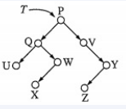
Consider the following binary search tree T given below:
Which node contains the fourth smallest element in T?
W
X
Y
Z

Slide 8
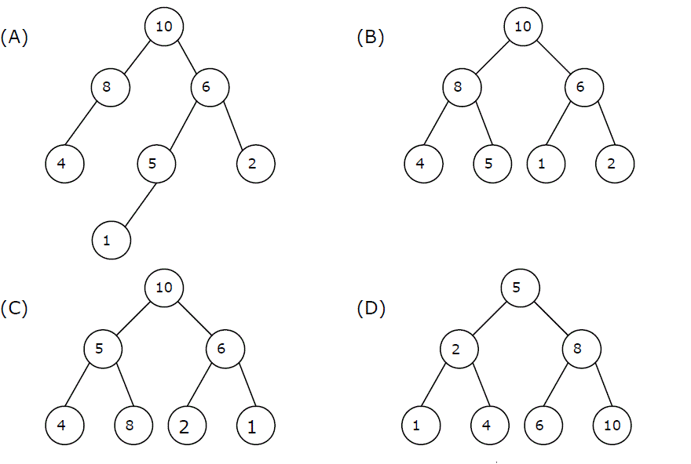
A max-heap is a heap where the value of each parent is greater than or equal to the values of its children. Which of the following is a max-heap?

Slide 9
Consider a binary max-heap implemented using an array. Which one of the following array represents a binary max-heap?
25,12,16,13,10,8,14
25,12,16,13,10,8,14
25,14,16,13,10,8,12
25,14,12,13,10,8,16

Slide 10
What is the content of the array after two delete operations on the correct answer to the previous question?
14,13,12,10,8
14,12,13,8,10
14,13,8,12,10
14,13,12,8,10

Slide 11
What is the maximum number of edges in an acyclic undirected graph with n vertices?
(A) n-1
(B) n
(C) n + 1
(D) 2n-1

Slide 12
Let G be a simple graph with 20 vertices and 8 components. If we delete a vertex in G, then number of components in G should lie between ____.
(A) 8 and 20
(B) 8 and 19
(C) 7 and 19
(D) 7 and 20

Slide 13
What is heap? write a function to create heap using bottom up approach

Slide 14
Write a function to create an expression tree for a given postfix expression.
Assume stack function, no need to write them.

Slide 15
A BT whose height of Left sub tree and right sub tree differ by height of 1 unit is called ________

Slide 16
The height of a BST is given as h. Consider the height of the tree as the no. of edges in the longest path from root to the leaf. The maximum no. of nodes possible in the tree is?
a) 2h-1 -1
b) 2h+1 -1
c) 2h +1
d) 2h-1 +1

Slide 17
Which of the following statement about binary tree is CORRECT?
a) Every binary tree is either complete or full
b) Every complete binary tree is also a full binary tree
c) Every full binary tree is also a complete binary tree
d) A binary tree cannot be both complete and full

Slide 18
Write a function that can find the number of connected components in a graph using depth first
search (DFS). Use the Adjacency Matrix representation of graph
Given a binary tree and a sum, return 1 if the tree has a root-to-leaf path such that adding up all the values along the path equals the given sum. Return 0 if no such path can be found..
A priority queue is implemented using max heap where the maximum element is at the root of the heap. Assume the integer array h[ ] stores the heap elements and count stores the number of heap elements. Implement a function called RemoveMax() to remove the maximum element of the heap and adjust to form a heap again

